Slide 1
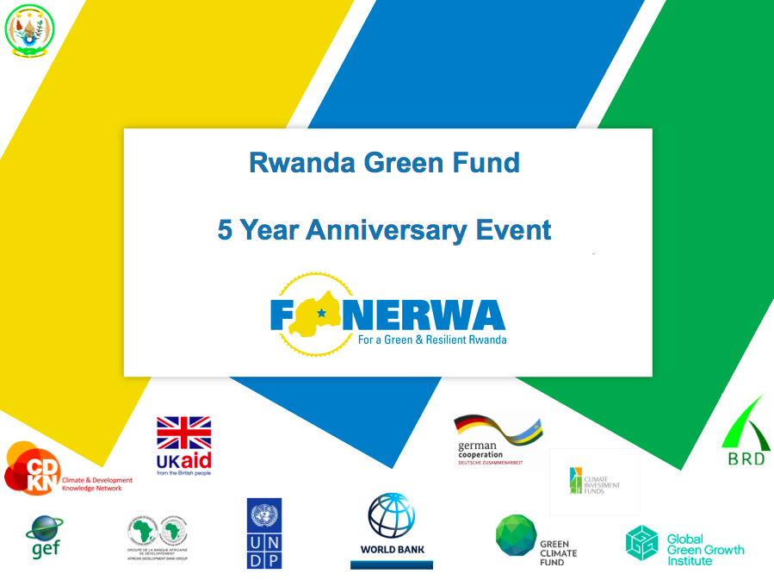
FONERWA
(RWANDA GREEN FUND)

Slide 2
OUTLINE
The “Big picture” of FONERWA
Financial Instruments
Fund Investments
Sources of climate finance
Lessons learned
Area of future investments

Slide 3
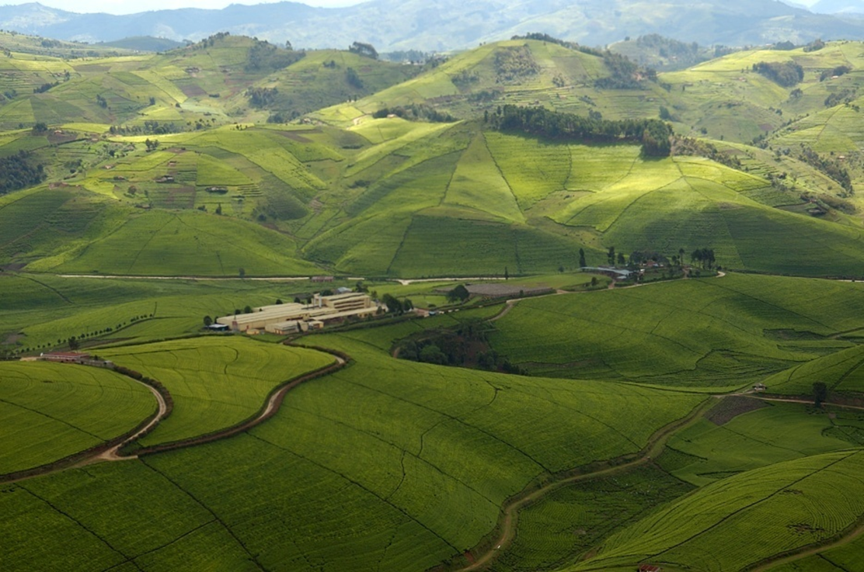
RWANDA GREEN FUND/FONERWA
A solution to Rwanda’s development challenges
Represent opportunity to attract climate finance to support resilience to climate change and green growth in Rwanda.
FONERWA invests in the best public and private projects that have the potential for transformative change.
The fund provides expert technical assistance to ensure the success of its investments

Slide 4
OUR VISION
The fund aims to be a dynamic, independent resource facility providing targeted financial and technical support as well as contributing to Rwanda’s vision of becoming a low-carbon and climate resilient economy by 2050.
Mission
To mobilize, manage, monitor and facilitate cross sector access to green and climate finance and provide financial and technical support to catalyze climate resilient development impacts at scale

Slide 5
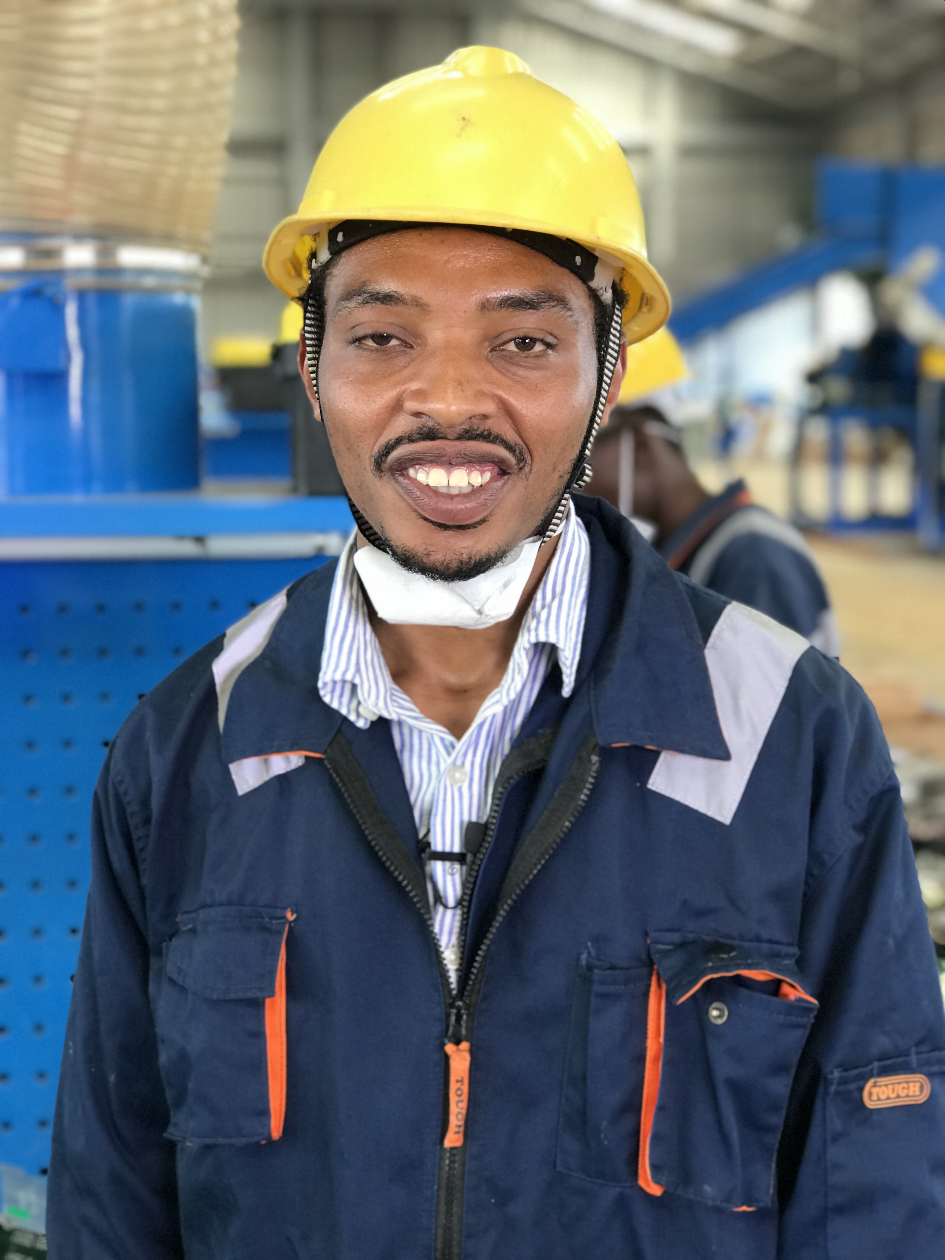
INVESTMENT AVENUES
Window 1:
Conservation & rehabilitation of natural resources
Window 2:
Window 3:
Environment & climate change mainstreaming
Window 4:
Environmental Impact Assessments (EIA)
Energy, R&D and technology transfer

Slide 6
FONERWA Window -Key Entry Points
Entry points 1:
Entry points 2:
Entry points 3:
SEA (including CC )
Entry points 4:
Monitoring and implementation of environmental management plans
Renewable energy & EE technology
Ecosystem rehabilitation
Sustainable Land management
IWRM
Sustainable Forestry
Mines and quarries
Pollution management
Irrigation technology
Sector-specific adaptation and mitigation,
Environmental Auditing
Applied and adaptive research (AF, waste, urban planning)
Disaster risk reduction
Promotion and protection of biodiversity
Data collection, monitoring & MIS
Support to cross-sectoral integrated planning (e.g. IDP, VUP)

Slide 7
FINANCIAL INSTRUMENTS
INNOVATION GRANT
This product is a performance based investment for research and development, proof-of- concept and demonstration. Private sector companies can apply for up to USD 300,000 and must provide 25% match funding.
CREDIT LINE
The Green Fund provides Rwanda’s cheapest money with a credit line that provides Financing at 11.45%, well below market rates. Developed with Rwanda’s Development Bank, private sector companies must provide 30% match funding.
GRANT
Accessed by Public institutional and NGOs

Slide 8
RESOURCE MOBLIZED
$ 173.5
MILLION USD MOBILIZED
FROM

Slide 9
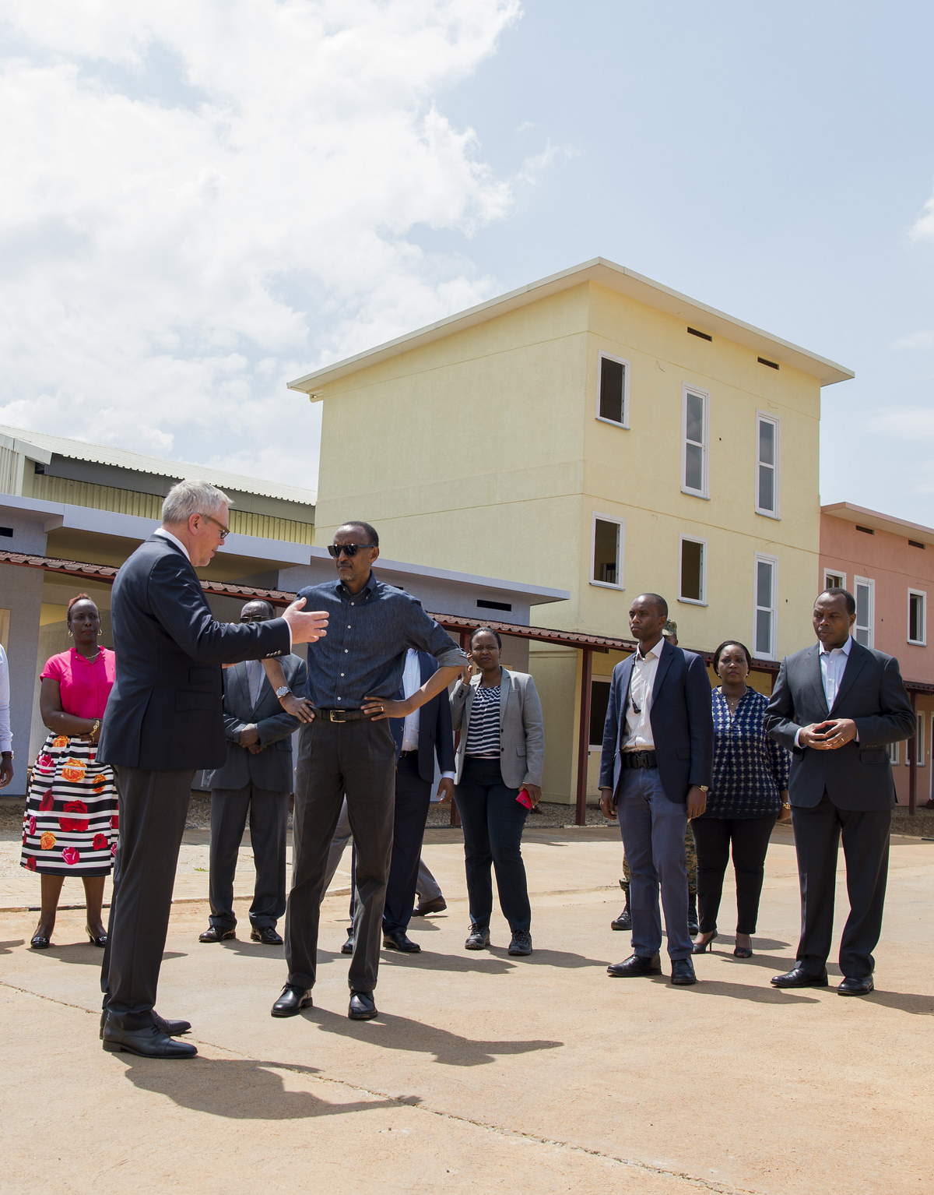
FUND
INVESTMENTS
PRIVATE SECTOR
7 projects
PUBLIC INSTUTITIONS
21 projects
NGOs & GoR
4 projects
NGOs
4 projects
36 Total projects

Slide 10
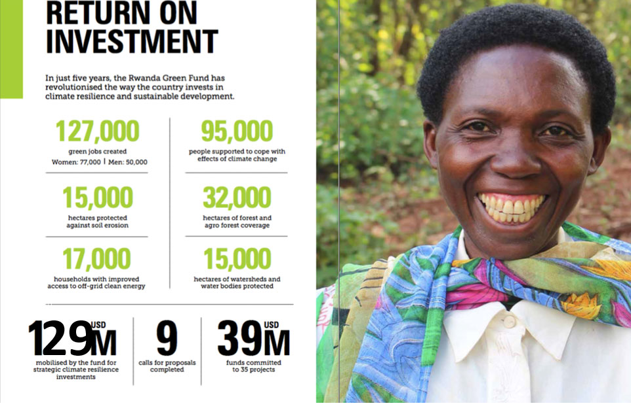
21,263 Area (ha) of land secured against erosion
42,197 Area (ha) forest and agro forest coverage
26,547 Area (ha) of watersheds and water bodies protected
70,528 households with access to clean energy
92,634 tons of CO2 avoided
108,695 Number of people supported to cope with effects of climate change
140,096 green jobs created

Slide 11
Key success to attract climate finance
Governance structure that create enabling environment for coordination – Ministries, development partners, civil societies and private sector
Government ownership and commitment to support green economy.
Domestic contribution
Bilateral and Multilateral engagement at national level
Mapping and engaging international climate funds to finance green programme
Seizing opportunities (Strategy Program for Climate Resilience (SPCR), Pilot Program for Climate Resilience (PPCR), Forest Investment Plan, NDC, and blended finance)

Slide 12
Evolution Vision
Seed capital 2013
FONERWA support to EDPRS II and the national Green economy agenda
Rwanda’s Development “Strategic orientation and Vision 2020”
FONERWA support to sustainable development agenda through successful implementation of GGCRS
Rwanda’s Climate Compatible Development”
V 2050 & Beyond
SDGs/NDC
V 2020 & NST
2017/Revised Law
Management Transition Sept. 2015
Implementation January. 2014

Slide 13
Key Lessons for the Strategic direction
Demand-led FONERWA to a more strategic, impactful and sustainable Green Finance Facility operating as hybrid fund
Diversify and accelerate private sector resources mobilization and access to green and climate finance
Strong technical skills and capacity critical to successful resources mobilization
Fiduciary standards: aligned to international standards to assure investor/contributor confidence
Robust resources mobilization including Private sector/PPP
The new Law to make the fund an effective nation considered critical al coordinator for mobilizing and managing climate finance

Slide 14
AREAS FOR FUTURE INVESTMENT
Immediate Focus Sectors
Second Wave
Biomass Replacement
Green Cities
Sustainable Transport
Waste
Climate Smart Agriculture
Creating opportunities to invest in biomass replacement and catalyze transition to sustainable biomass value chains.
Support a paradigm shift in green urbanization by brokering investment in major flagship urban initiatives.
Stimulate investment in low-carbon vehicles and e-mobility to support affordable access to markets and livable cities.
Tackle the urban waste challenge and introducing opportunities for circular economy investments across the value chain.
Renewable Energy
Water
Possible sector investment priorities (under analysis)
A second phase of high-potential sectors could be elaborated subsequently
Clean Domestic Fuel & LPG
Bio-digestion
Sustainable charcoal
Kigali Pilot in Kinyinya
Rollout in secondary cities
Green Buildings
E- Vehicle Infra
Bus Rapid Transport
Electric Scooters
Upgrade landfill
Waste to energy
Could be combined with Biomass

Slide 15
Climate Finance opportunity
Green Climate Fund
Climate Investment Funds
Least Developed Countries Fund
Adaptation Fund
NAMA Facility
Special Climate Change Fund
Forest Carbon Partnership Facility
Global Climate Change Alliance

Slide 16
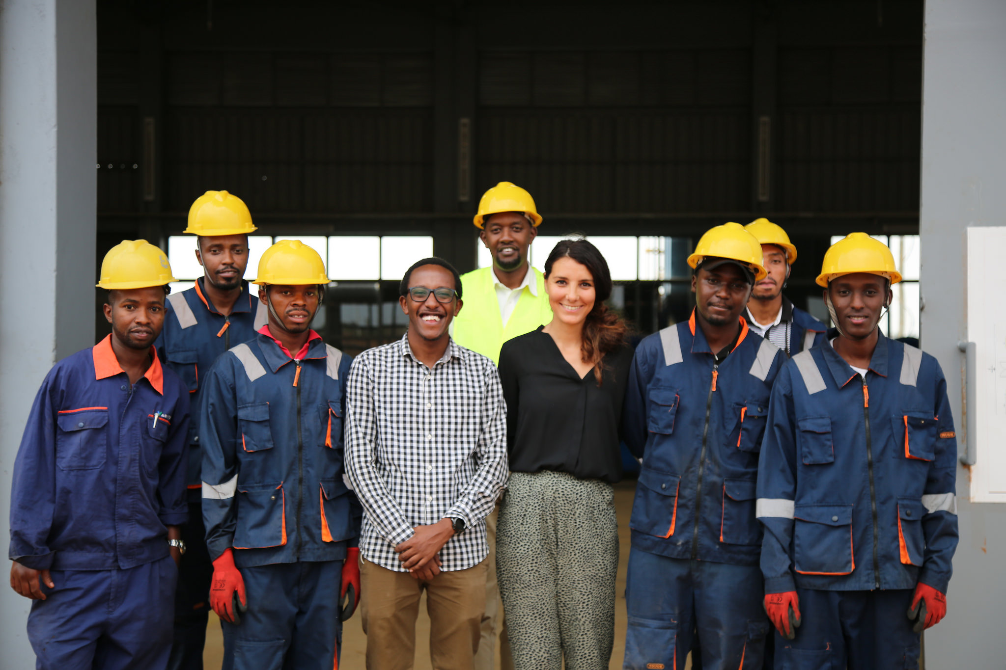
OUR PARTNERS
We are thankful to our partners who have joined us on this journey to build a green Rwanda and we look forward to even greater impact in the future.

Slide 17
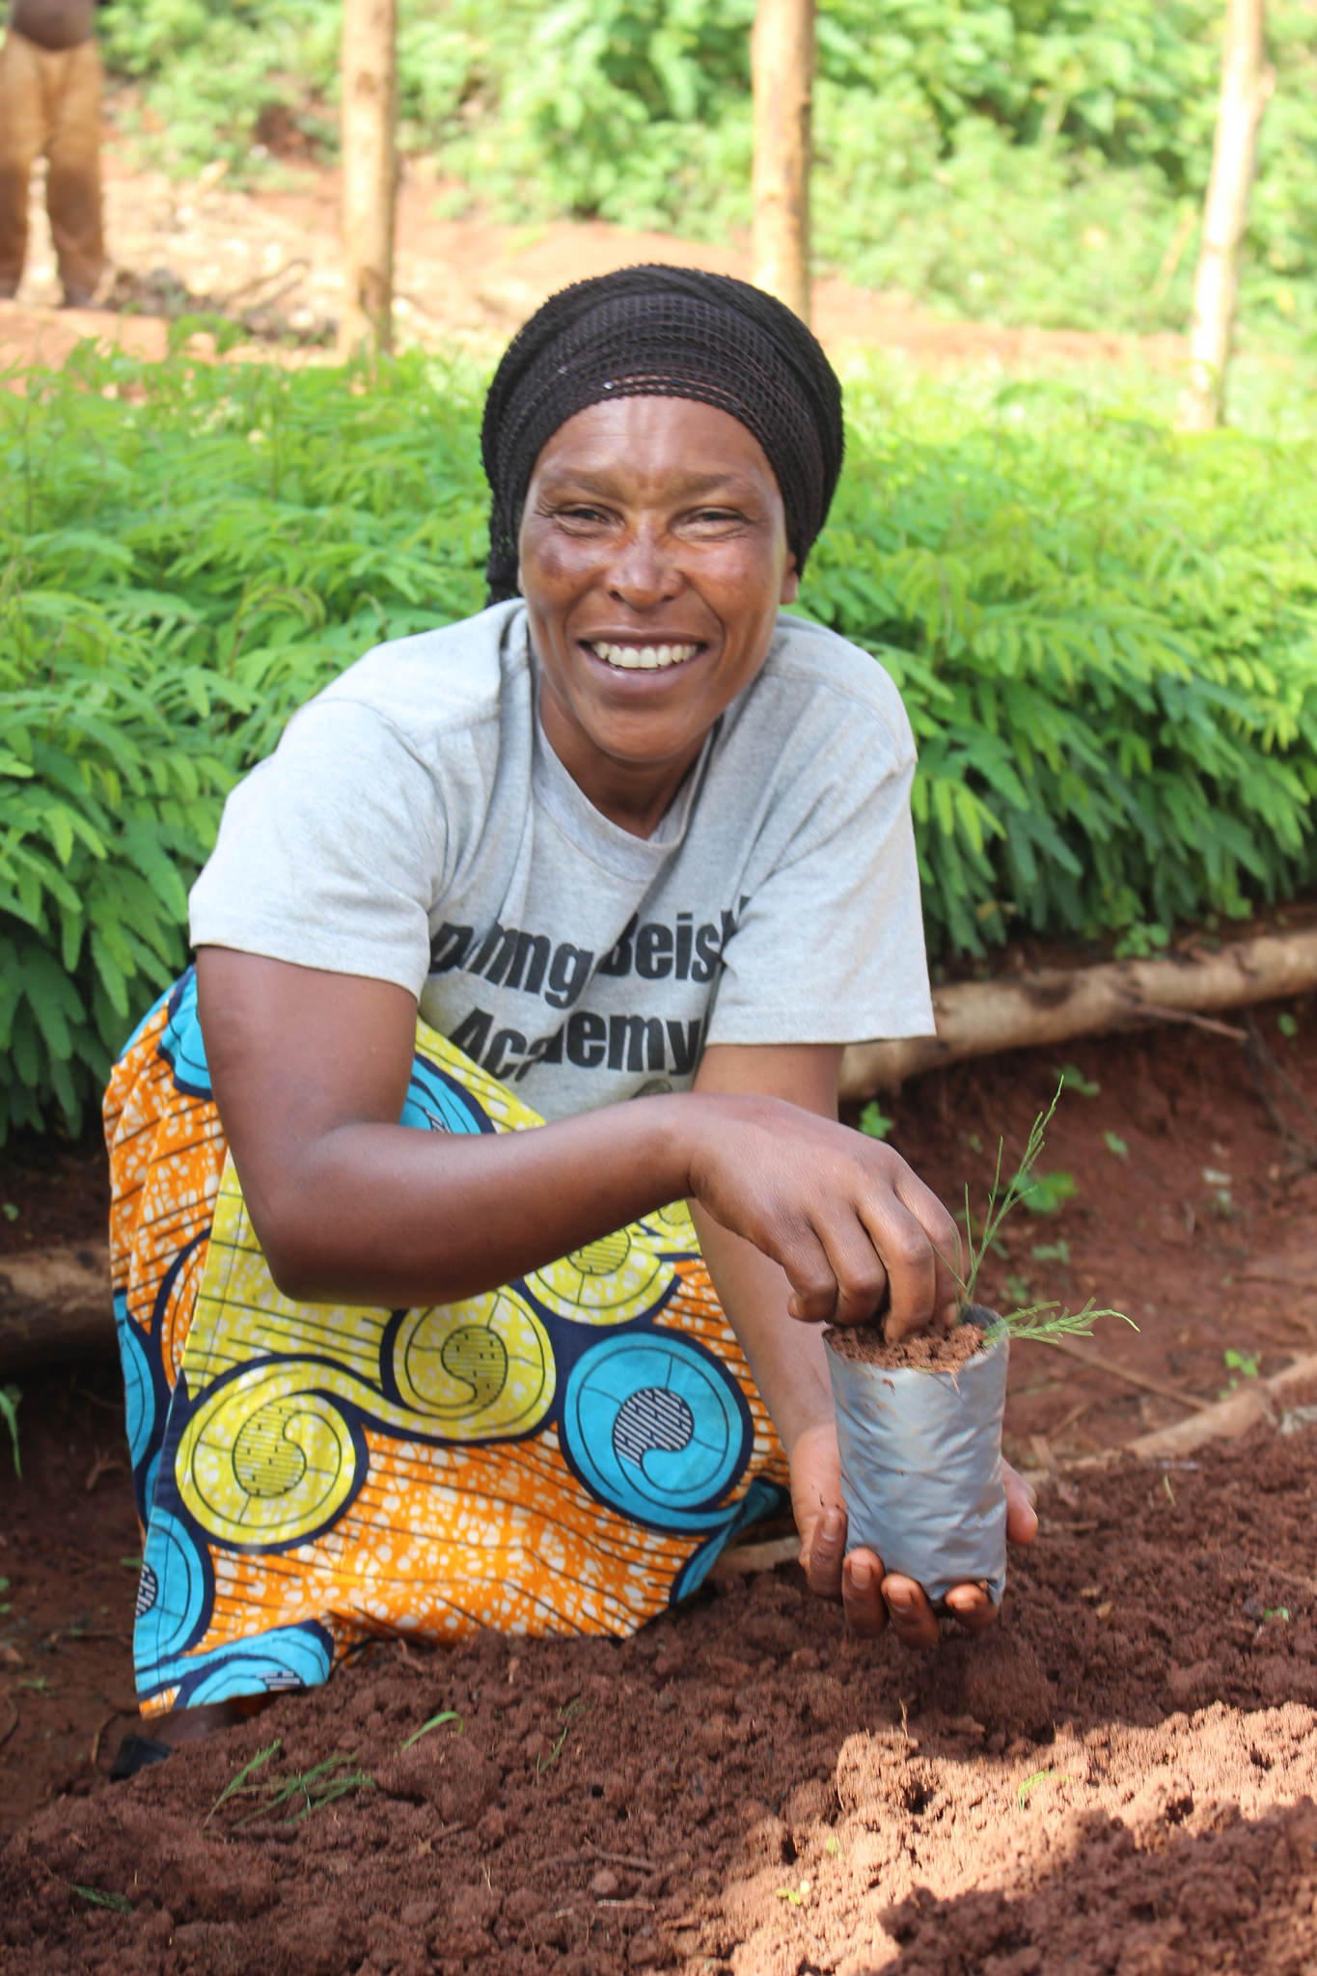
JOIN RWANDA’S CLIMATE CHAMPIONS
The fund’s success rests in the hands of us all as we shape the future of our country every day.
Become a climate champion and invest in Rwanda to develop a strong, climate resilient and sustainable green economy.
Thank you! Murakoze!
www.fonerwa.org
@GreenFundRw

Slide 18
THANK YOU

