Slide 1
Uganda NDC enhancement
Gloria Namande, UNDP NDC Support Programme

Slide 2
Presentation layout
Why the NDC enhancement
UNDP Climate Promise
Key considerations for Uganda’s NDC update
Steps undertaken in NDC update process
Success factors

Slide 3
Why NDC enhancement
Under the Paris Agreement countries are invited to communicate updated NDCs to the UNFCCC by 2020 and every five years
Need to enhance the quality and increase ambition
Translate efforts into a continuous improvement towards a low carbon development pathway

Slide 4
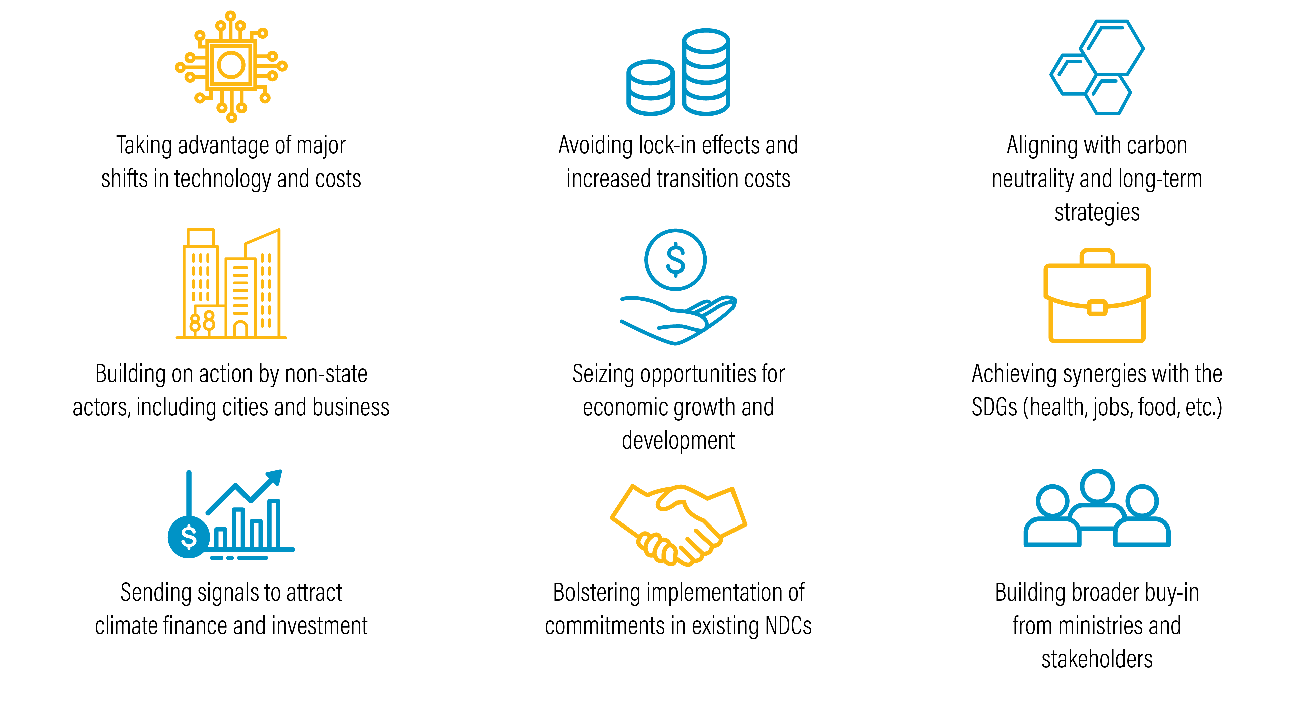
Why Enhance NDCs

Slide 5
Increasing ambition through NDC enhancement

Slide 6
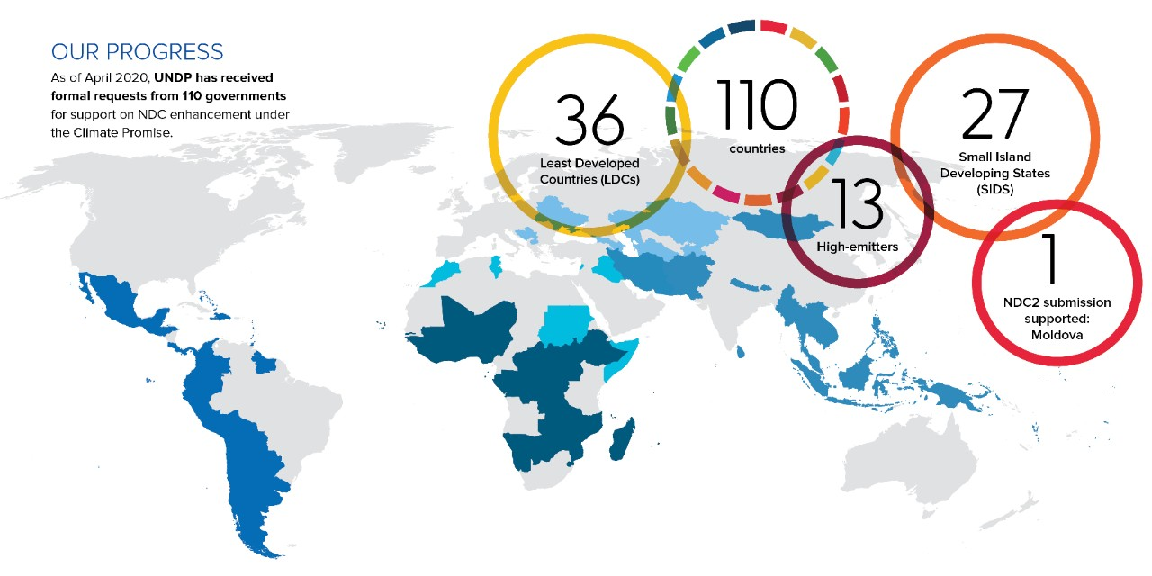
UNDP Climate Promise
Notes:
Under the Climate Promise, UNDP is supporting atleast 110 countries to enhance their NDCs
Involves engagement of government, citizens, private sector, and other key stakeholders and partners – bringing all voices to the table to agree ways to curb GHG emissions while also creating more resilient communities and protecting natural spaces.

Slide 7
UNDP Climate Promise
Countries must take urgent action to transition to resilient, low-carbon pathways to limit global temperature rise to a safe 1.5C
Countries supported to undertake an inclusive and transparent process to revise their NDCs
Involves engagement of government, citizens, private sector, and other key stakeholders and partners
Governments to tackle climate change through their NDCs is one of the most effective ways to achieve transformation at the necessary scale and breadth
Notes:
Failure for Countries to undertake urgent climate action will result in increased damages from disasters, destabilized economies and financial markets and forced migration of major population

Slide 8
Key considerations for Uganda’s NDC update
Alignment with the developments of the Uganda’s third National Development Plan 2020/21- 2024/25
Revision of policies and regulatory frameworks e.g. energy policy as entry points to raise ambition.
Consideration of the climate change bill as legal backing to support government action towards NDC implementation.
Alignment of the NDC implementation process with the Country's Vision 2040 , Uganda Green Growth Development Strategy 2030 and the SDGs.

Slide 9
Key considerations for Uganda’s NDC update
Review, align, and update existing targets, policies and measures
Incorporate new sectors and/or greenhouse gases
Alignment with policies and measures including NDPIII, GGDS, SDGs
Elaborate adaptation targets to identify resilience actions to combat future climate hazards
Disaggregate and quantify current mitigation targets and additional sector emission targets
Conducting metabolic assessment through the analysis of the flows, conversions and stocks of materials and based on that,
incorporating additional sectors not catered for at the moment

Slide 10
Key considerations for Uganda’s NDC update
Assess costs and investment opportunities
Monitor progress & strengthen transparency
Data collection and management
Cost-benefit analysis to define costs and benefits of adaptation and mitigation actions including nature-based solutions, transport, industry and waste sectors
Elaborate domestic financial instruments for NDC implementation.
Update standardized baseline for improved institutional cookstoves
Develop National emission factor for the waste sector based on IPCCC guidelines
Integrate the new default factors in the online MRV tool for Uganda’s NDC

Slide 11
Steps in the NDC update process for Uganda
Inception meetings
Stakeholder consultations (government ministries including the NDC working group, academia, private sector,, NGOs,
Report on enhanced mitigation and adaptation targets, emission factors for validation
Draft revised NDC for approval by stakeholders
Final NDC for submission to UNFCCC
- Communication and sharing of knowledge products

Slide 12
Key success factors
High level buy-in and government ownership
Inclusive stakeholder engagement
Institutional coordination for example through NDC coordination working group
Synergies with ongoing processes (LTS, NDCP, MRV tools)
Communication, raising awareness and sharing of knowledge

Slide 13
THANK YOU

