Slide 1
Climate Action status in Chile/carbon tax update CPLC Americas Working Group Call Tuesday, May 19, 2020 Juan Pedro Searle

Slide 2
GHG emissions in Chile: 1990-2016
52 MMton
94 MMton
111 MMton
46 MMton
50 MMton
56 MMton
65 MMton
Source: 3rd BUR, Ministry of Environment

Slide 3
In Chile, the energy sector accounts for 78% of CO₂e emissions
CO₂e
All references to CO₂e, refer to greenhouse gases (GHG) such as:
Carbon dioxide (CO2),
Methane (CH4),
Nitrous oxide (N2O),
Hydrofluorocarbons (HFC),
Perfluorocarbons (PFC),
Sulfur hexafluoride (SF6),
measured in CO₂ equivalent units
Based on National Greenhouse Gas Inventory (INGEI) data, year 2016.
Notes:
Global País: 78% Energía, 11% Agricultura, 6% IPPU (procesos industriales y manufactura) y 5% Residuos.
Sector eléctrico 32% : 25% carbón, GNL (4,5%) y otros (2,5%).
Transporte 24%: 21% terrestre, 1% aviación y 2% otros (marítimo, ferroviario y otros).
Industria 14%: 7% minería, 1% pulpa papel e imprentas y 6% otros.
Edificación 7%: 4% residencial, 3% Comercial, institucional y otros sectores.
Gases de efecto invernadero regulados por Protocolo Kioto:
Dióxido de carbono (CO2)
Metano (CH4)
Óxido nitroso (N2O)
Hidrofluorocarbonos (HFC)
Perfluorocarbonos (PFC)
Hexafluoruro de azufre (SF6)

Slide 4
Carbon Neutrality 2050
130
Reference scenario
Sustainable industry (25%)
Green hydrogen (21%)
Electromobility (17%)
50%
(65 MtCO2_{e})
Sustainable building (17%)
Coal phase out (13%)
Energy efficiency (7%)
Mantain forest capture
50%
(65 MtCO2_{e})
Carbon neutrality scenario
Forest carbon capture
Carbon Neutrality
Note: considers a capture of 57 MM tons per year from the forestry sector, plus an increase of 8 MM tons in 2050. The reduction percentages represent the aggregate for the period 2020-2050.
Notes:
Como leer el gráfico:
Línea roja superior representa las emisiones absolutas en el escenario de referencia (sin medidas de mitigación adicionales)
Línea verde (abajo) representa las emisiones netas: (emisiones absolutas menos captura y mitigación). En este escenario el peak de emisiones se estaría dando antes del año 2030 (2028).
Sobre lo verde serían las emisiones totales de la economía en el escenario carbono neutral.
*MtCO2e = millones de toneladas de dióxido de carbono equivalente

Slide 5
Chile has updated it’s NDCs
 |  | Current NDC | New NDC (proposal)
 | GHG | Emission intensity (tCO2/PIB): - 30% (unconditional and - 45% (conditional) by 2030 Based on 2007 emissions. | Absolute emissions: 95 MMtCO₂ by 2030
 |  |  | Carbon budget 2020-2030: 1,100 MMtCO₂
 |  |  | Emissions Peak: 2025
 | Black carbon | No goal | At least 25% by 2030, based on 2016 emissions. Achieved mainly through National Air Quality Policies.
 | Sustainable Management | 100,000ha mainly with native species. | 200,000ha with native species, by 2030.
 |  | Conditional to Native Forest Bill. | Equivalent to a reduction between 0.9-1.2 MMtCO₂ by 2030.
 | Afforestation | 100,000ha mainly with native species. | 200,000ha: at least 100,000ha with permanent coverage; of these, at least 70,000ha with native species.
 |  |  | Equivalent to a reduction between 3.0-3.4 MMtCO₂ by 2030.
 | Reduce degradation and deforestation | No goal | Reduction of 25% of emissions due to degradation and deforestation of the native forest by 2030, considering the average emissions between 2001-2013.
 |  |  | Equivalent to a reduction between 2.5 - 3.0 MMtCO₂ by 2030.

Slide 6
Measure contributions by 2050
Sustainable Industry
25%
Green Hydrogen¹
21%
Electromobiity
17%
Sustainable Building²
17%
Coal Phase Out
13%
EE
7%
Minimum energy standards engines (100HP)
Energy management systems 2.5%
Coal phase out
Distributed generation PV
Electric heating – public, commercial
Vulnerable housing insulation
Insulation improvement existing homes
Solar thermal systems
Electric heating- residential
Taxis 100%
Private vehicles 60%
Public transportation – RM
Commercial vehicles 60%
Public transportation – regions
Freight transport
Engine uses
Biogas generation
Engine electrification – other mining
Engine electrification – commercial
Engine electrification – industry
Thermal electrification
Engine electrification— copper mining
Solar thermal systems
Electric heating in homes
2050 Goal
57% houses
70% apartments
Green hydrogen replaces diesel in engine uses in industry and mining.
2050 Goal
37% open pit mining
8% underground mining
12% various industries
Coal power plant phase out.
2040 Goal
100% coal power plant withdrawal
Green hydrogen replaces diesel use in freight transport.
2050 Goal
85% of transport with a capacity over 5 tons
¹ Gas pipelines measure is not graphed (<1%). ² District heating and geothermal are not graphed (<1%). ³ EE: Energy efficiency. Modal shift and new minimum energy performance standards are not graphed (<1%).

Slide 7
Carbon/local pollutants tax: two years of successful operation
FY 2017: First year of operation
Regulated installations:
– Boilers and Turbines
Regulated pollutants:
– CO_{2,} PM, NOx, SO₂
5 US$/Ton CO₂
CO₂: 33,6 MMTon
PM: 5,3 kTon
NOx: 51,7 kTon
SO₂: 43,8 kTon
CO₂: 33,3 MMTon
PM: 4,9 kTon
NOx: 50,7 kTon
SO₂: 43,8 kTon
MUSD 191
MUSD 187

Slide 8
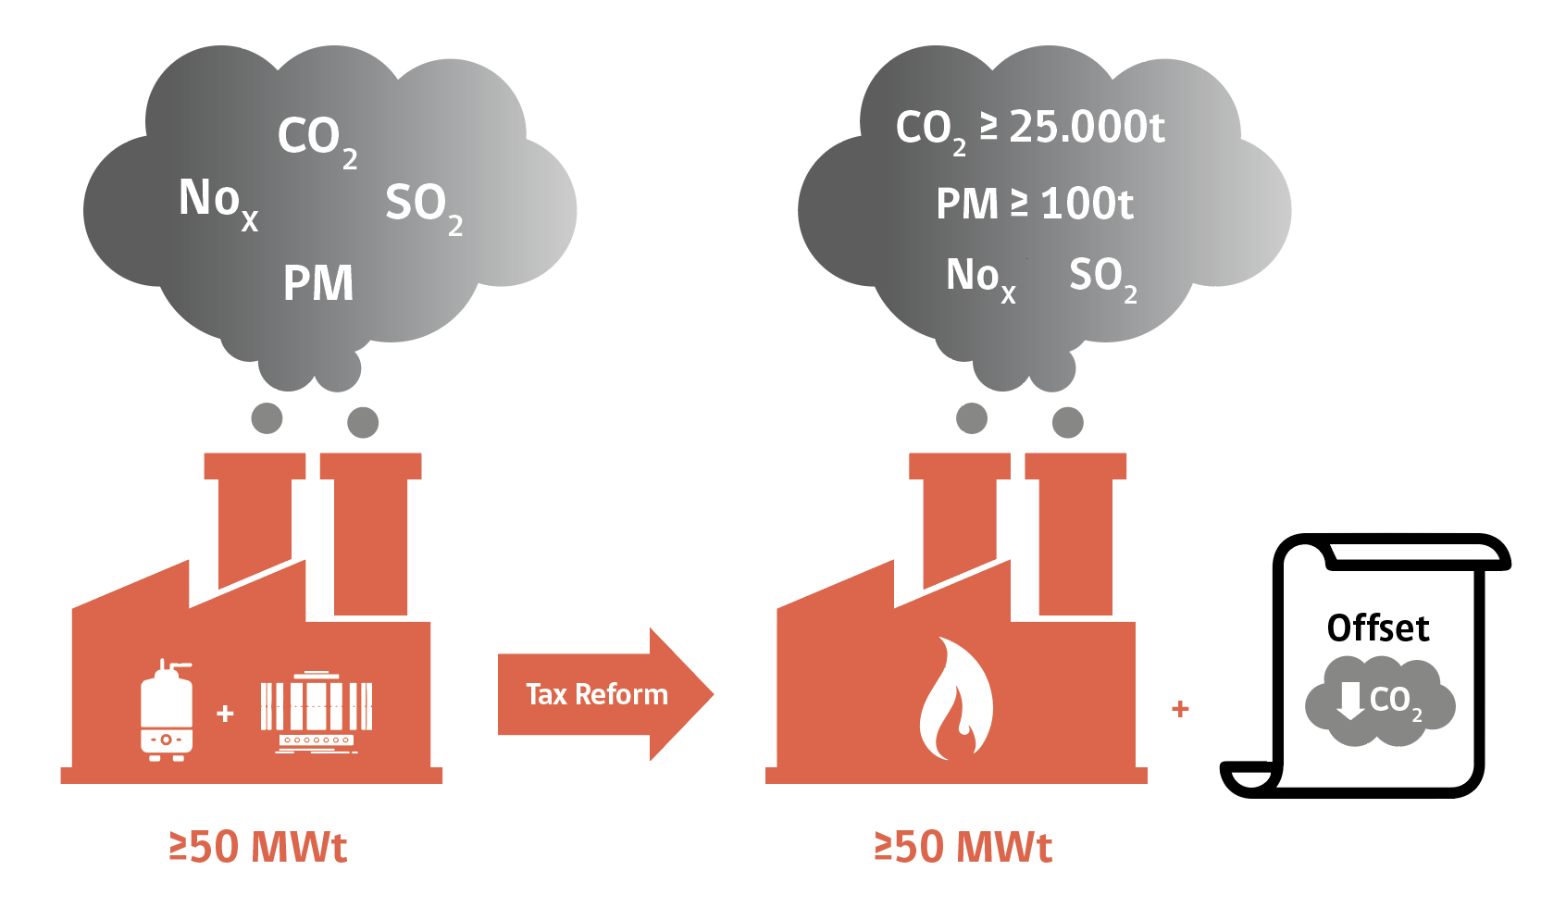
Changes to the Green tax
August 2018: President Piñera sent a national tax reform to Congress, including two major changes to the green tax
Change in threshold
Regulated installations
> 25,000 tCO₂ and/or > 100 tMP
Only combustion processes
Creates a complementary offsets scheme
For GHG and local pollutants
Was approved by both chambers of the National Congress last January.

Slide 9
Climate Change framework bill
The bill is in Congress since on Jan 9th
Main figures:
Establishes a carbon neutrality goal by 2050.
Creates a Long-term Climate Strategy.
Assigns sectoral responsibilities for mitigation and adaptation measures.
Establishes limits for GHG and black carbon (by installation, groups of sources, sectors…)
Strengthens and give continuity to policies, plans, programs and actions on climate change.
Carbon Pricing:
Creates a market to trade the emission reductions resulting from the surplus in the fulfilment of the emission limits and from mitigation projects elsewhere to meet the standards.
Accepts the use of ITMOs from international sources.

Slide 10
Climate Action status in Chile/carbon tax update CPLC Americas Working Group Call Tuesday, May 19, 9:00-11:00 AM EST

