Slide 1


EMISSIONS TRADING WORLDWIDE: Status Report 2020
Stephanie La Hoz Theuer, Senior Project Manager, ICAP Secretariat

Slide 2





Well designed ETS – A critical part of the transition towards net zero
2019 push for carbon neutrality: national targets, new policy strategies
ETS: key role in broad, cost-effective abatement; key component of transition
Carbon pricing must be supported by carefully crafted policy packages to unlock the necessary abatement potential

Slide 3
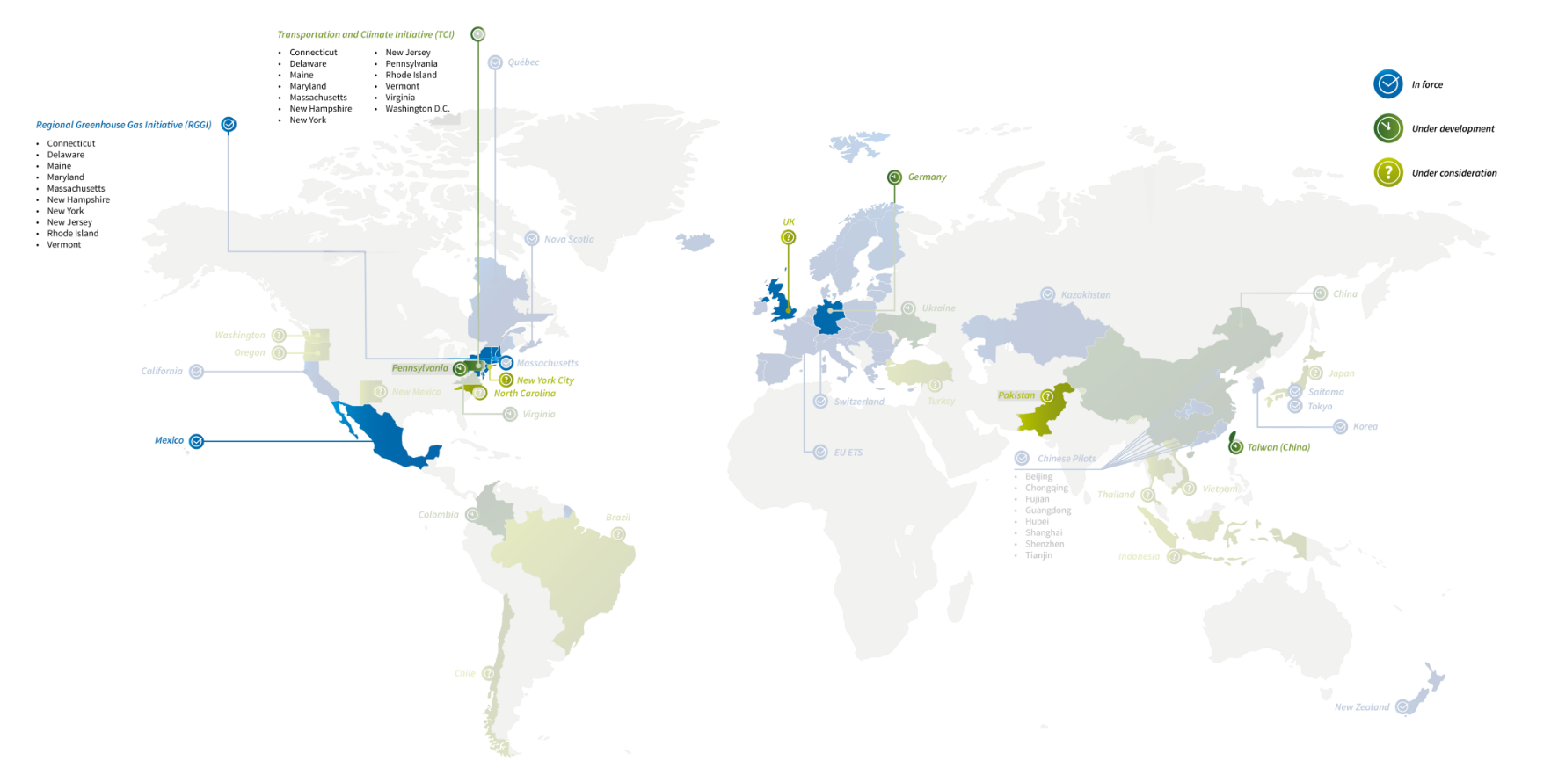











ETS is expanding globally
21 ETS operating
24 under development or consideration in diverse regions and economies
Germany
UK
Pennsylvania
NYC
Pakistan
North Carolina
Montenegro
Mexico
Philippines

Slide 4
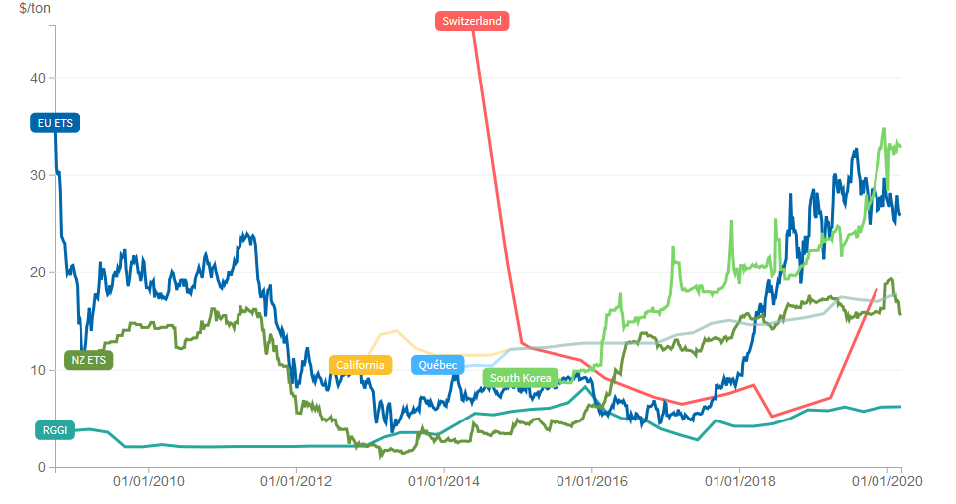
Allowance prices
COVID-19 will place downward pressure on allowances prices
USD
Prices have already responded to the crisis
Lower prices during a recession is part of a “market based approach”
South Korea**
$32.75
$25.83
EU ETS**
California*
$17.87
Québec*
All mature systems have in place automatic adjustment mechanisms to respond to external shocks
New Zealand**
$15.58
Switzerland*
$18.32
$6.23
RGGI*
Last updated: March 31 2020
(WHO declared COVID-19 a global pandemic on 11 March 2020)
*primary market data
**secondary market data

Slide 5

Thank you for your attention!
stephanie.lahoztheuer@icapcarbonaction.com
www.icapcarbonaction.com
info@icapcarbonaction.com
@ICAPSecretariat

