Slide 1
NDC Implementation and response to NDC update and Long-Term Strategies
May 19, 2020

Slide 2
Overview (partial) of NDCs and LTS in the LAC
* Based on the LEDSenLAC Report 2019 and complemented by IDB staff.

Slide 3
NDC Invest: focus areas of support
1. Enhancing ambition on new NDC design
2. Finance strategy for mobilizing & aligning investments
Emphasis on implementation
Tailored to country context
Science based
Iterative and consultative
Responds to a just transition and broader development objectives
Considers specific actions for the short, medium and long term

Slide 4
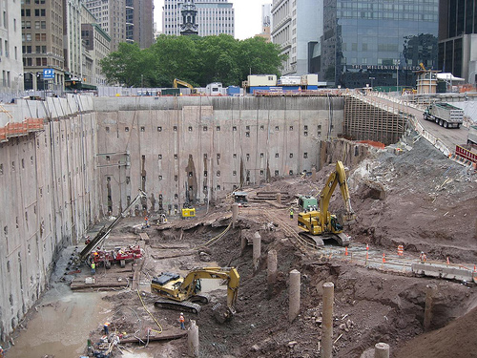
Long-term planning: transformational, not incremental, changes
-100%
The aim of the NDCs should be to build the foundations for decarbonization, not just achieving a given level of reduction at the lowest cost.
Emissions reduction
-20%
Time
4

Slide 5
Response on the Policy side
Argentina
Barbados
LTS adaptation
Bolivia
LTS mitigation
1. Development of NDC/LTS
Chile
New NDC
Policy change/Advise
Colombia
Costa Rica
Dominican Rep.
IDBG Portfolio
Ecuador
Cost-Benefit analysis
Jamaica
Green budgeting
2. Finance strategy for mobilizing & aligning investments
Mexico
NDC Pipeline development
Paraguay
Finance strategy & instruments
Analysis fiscal impacts
Peru
National Investment System
Suriname
Transparency frameworks
Uruguay

